Slide 1


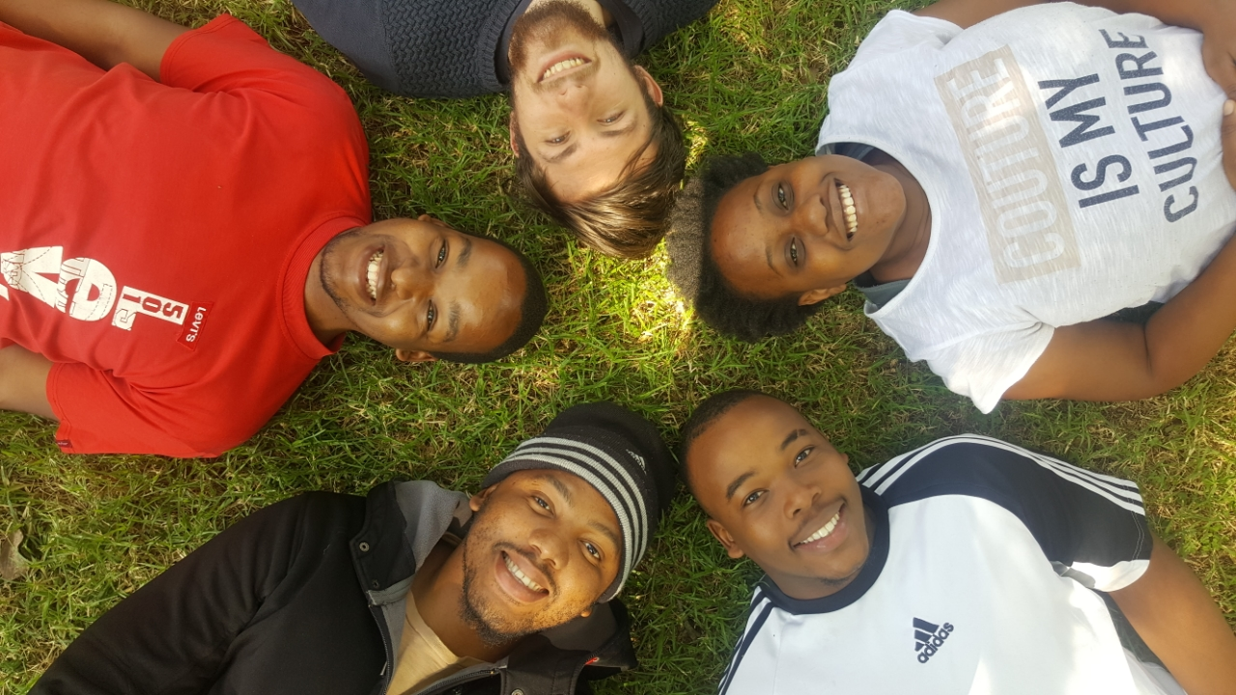
INDOOR MALL NAVIGATION
BRUTE FORCE

Slide 2

ROLES OF TEAM MEMBERS
THOMAS HONIBALL (Group Leader):
Unit testing
Integration testing
- Database setup
THABO NTSOANE:
Development
Documentation
Expo Setup (UI)
MPHO MASHABA:
Development
Documentation
- Project Management (Zenhub)
MUNYADZIWA TSHISIMBA:
Development
Documentation
Research
BANDILE DLAMINI:
Documentation
Development
Research

Slide 3
PROJECT DESCRIPTION
Create a fully interactive mall guide of sorts which will allow users to easily find shops as well as act as a shopping companion, providing a list of available specials within a store based on location as well as allowing users to add items to a shopping cart to purchase and have delivered later. This system also aims to replace electronic maps using augmented reality to guide users to a selected store.

Slide 4
TECHNOLOGIES USED
SQLITE - Database
EXPO – Testing implementation
REACT NATIVE - implementation
ZENHUB – Project Management tool
JEST – Integration testing
TRAVIS-CI – integration testing

Slide 5
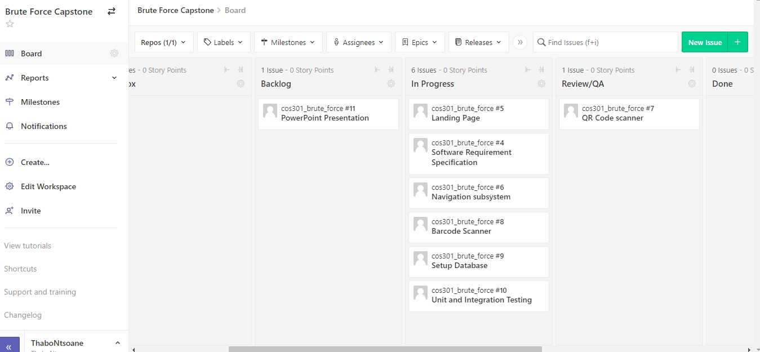
PROJECT MANAGEMENT TOOL
WE USED ZENHUB AS OUR PMT BY CREATING ISSUES THAT NEED TO BE RESOLVED

Slide 6
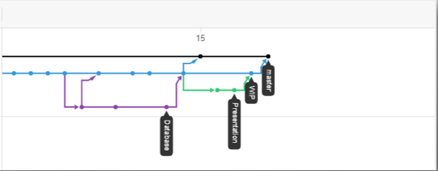
GIT STRUCTURE

Slide 7
DEMO
…

